Slide 1
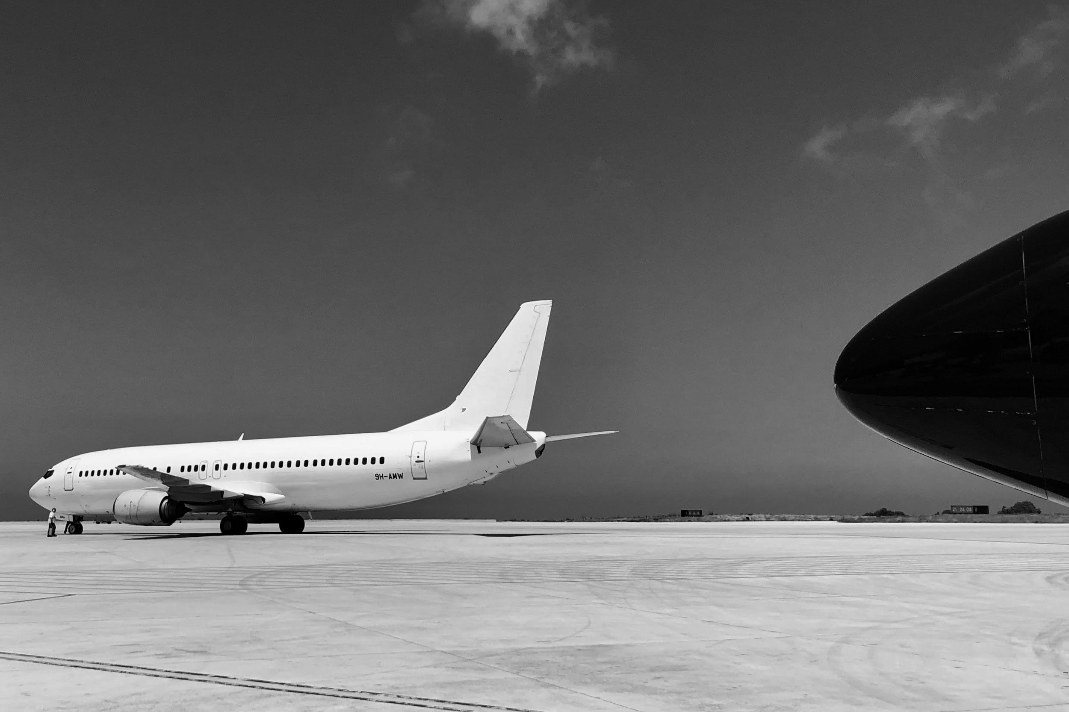
Aegean Airlines Passenger Satisfaction

Slide 2
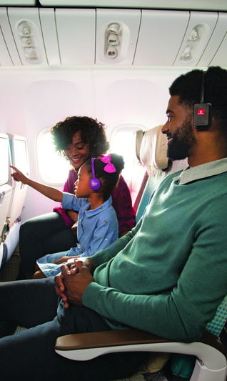
Introduction
In earlier days, airline companies were only interested in the transportation of people and their safety. But in recent times they consider giving a pleasant experience to customers from buying a ticket for their journey till they reach their destination is just as important.
Measuring customer satisfaction is a key element for modern businesses as it can significantly contribute to a continuing effort of service quality improvement (Tsafarakis, Kokotas and Pantouvakis, 2018).
The Aegean airlines which is one of the leading airlines has conducted a survey to identify the customer satisfaction towards their services provided.

Slide 3

Description of the problem
The Aegean Airlines needed to know how they can increase the number of passengers by providing more satisfaction towards their services.
The study aims to examine the most important factors that influence the passenger’s expectation from an airline services from the given dataset.
This can help the Aegean airlines to create a marketing strategies and quality improvement mechanism plan effectively to cope up with the other competitor airlines.
Finally, creating a website for Aegean airlines with the main feature that will predict whether a customer is satisfied or not.

Slide 4
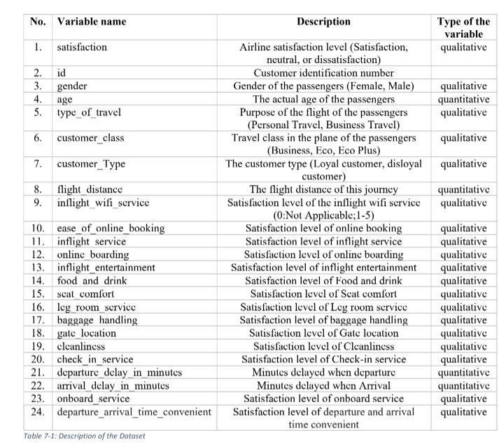
Dataset Description
The dataset is contained an airline passenger satisfaction survey data.it consists of 130k customer feedbacks containing 24 features including both qualitative and quantitative.

Slide 5
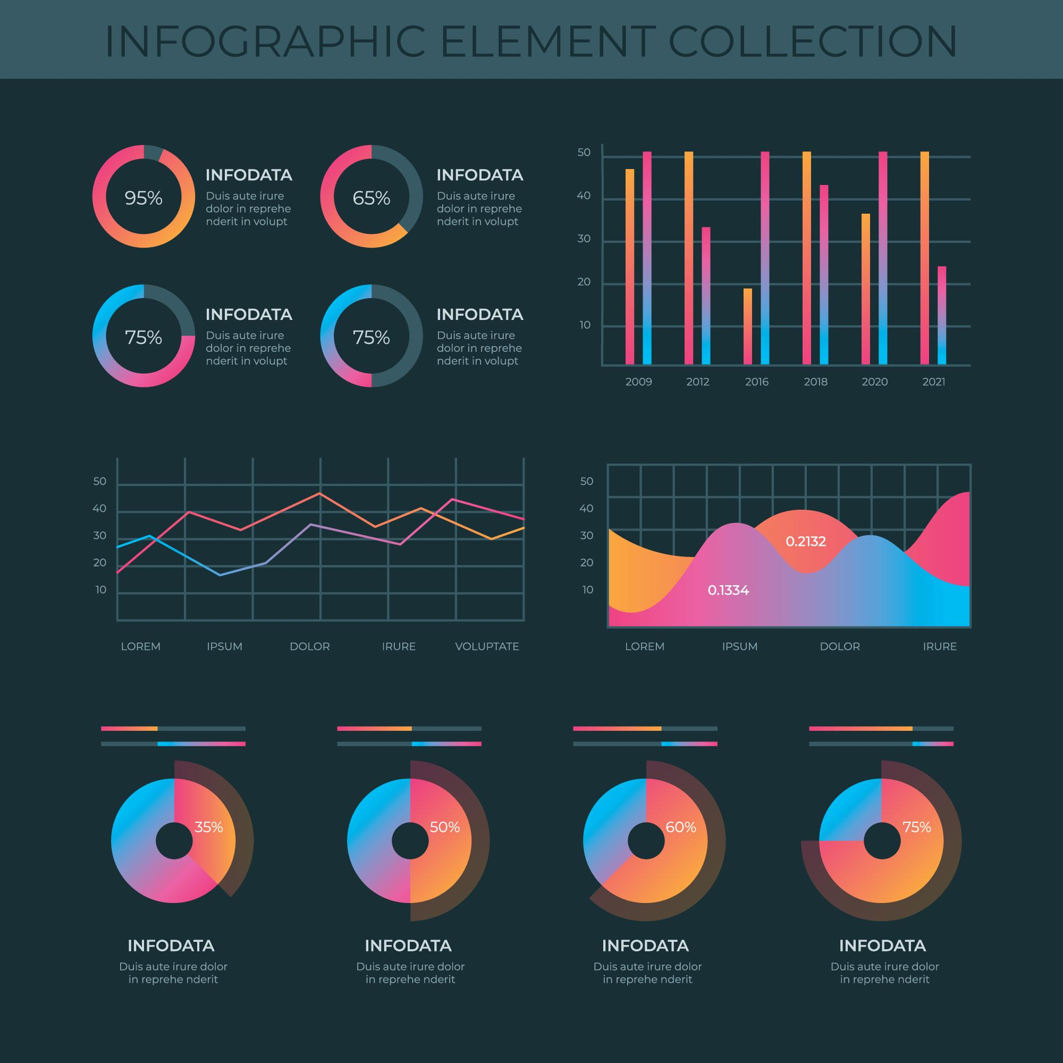
Summary of Descriptive Analysis

Slide 6
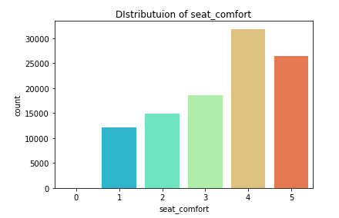
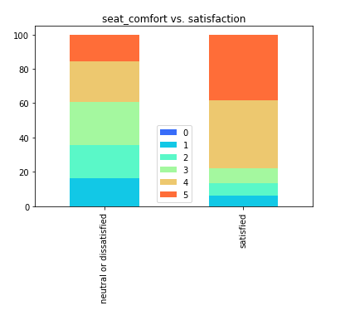
Summary of Descriptive Analysis
Most of the customers selected 3 to 5 levels. Hence the satisfaction level of seat comfort is high.
Majority of the customers who selected seat comfort satisfaction level 4 and 5 are satisfied with airline.
Also, majority of the customers who selected seat comfort satisfaction levels 1,2 and 3 are neutral or dissatisfied with the airline.

Slide 7
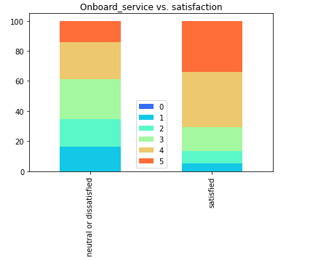
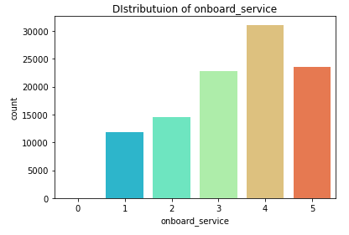
Summary of Descriptive Analysis
Here we can see that most of customers who selected onboard service satisfaction level 4 and 5 are satisfied with airline.
Also, majority of the customers who selected onboard service satisfaction levels 1,2 and 3 are neutral or dissatisfied with airline.

Slide 8
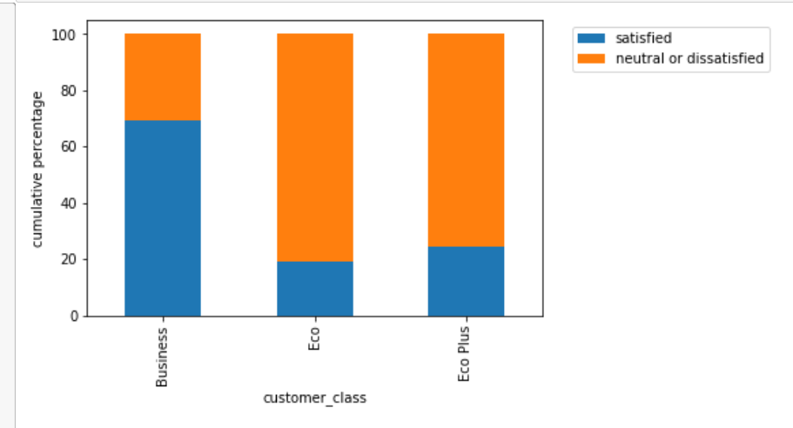
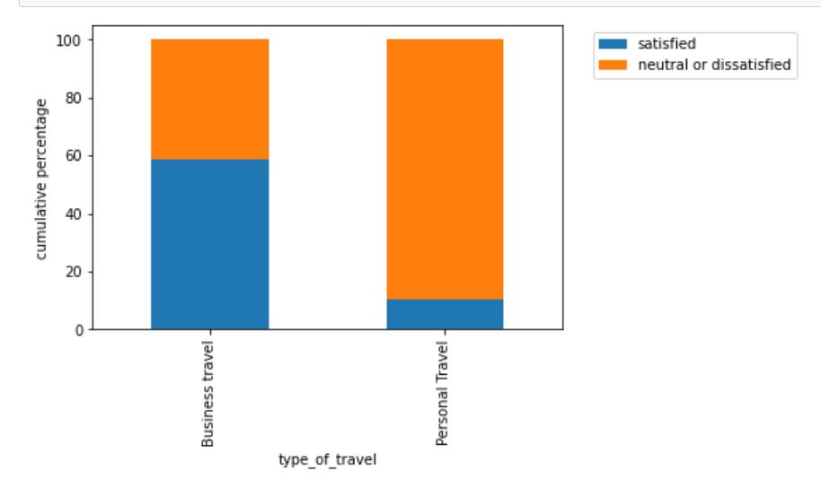
Summary of Descriptive Analysis
Business class have upgraded services than the economy class and customers travel in business class are most probably satisfied with the airlines. (USA today) (Covington travel). Here we can see that the people travel in business class ae more satisfied than the economy and economy plus class.
People who travel for personal reasons are more dissatisfied with the airlines than the people who travel for business reasons.

Slide 9
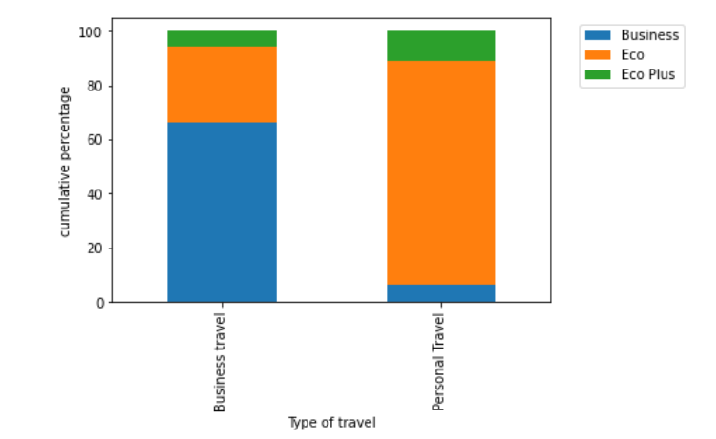
Summary of Descriptive Analysis
That can be due to the fact that people who travel for personal purposes travel in Economy or Economy plus classes as they are cheap and people travel for business purposes travel in business class.

Slide 10
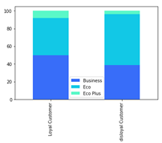
Summary of Descriptive Analysis
As earlier found out, the people who fly in economy class are more dissatisfied than the people who fly in business class.
From the graph, it is clear that most disloyal customers travel in economy class.
This can be a reason for the majority dissatisfaction among the disloyal customers.
The airline has to give more concern to develop economy class facilities in order to maximize customer loyalty and satisfaction.

Slide 11
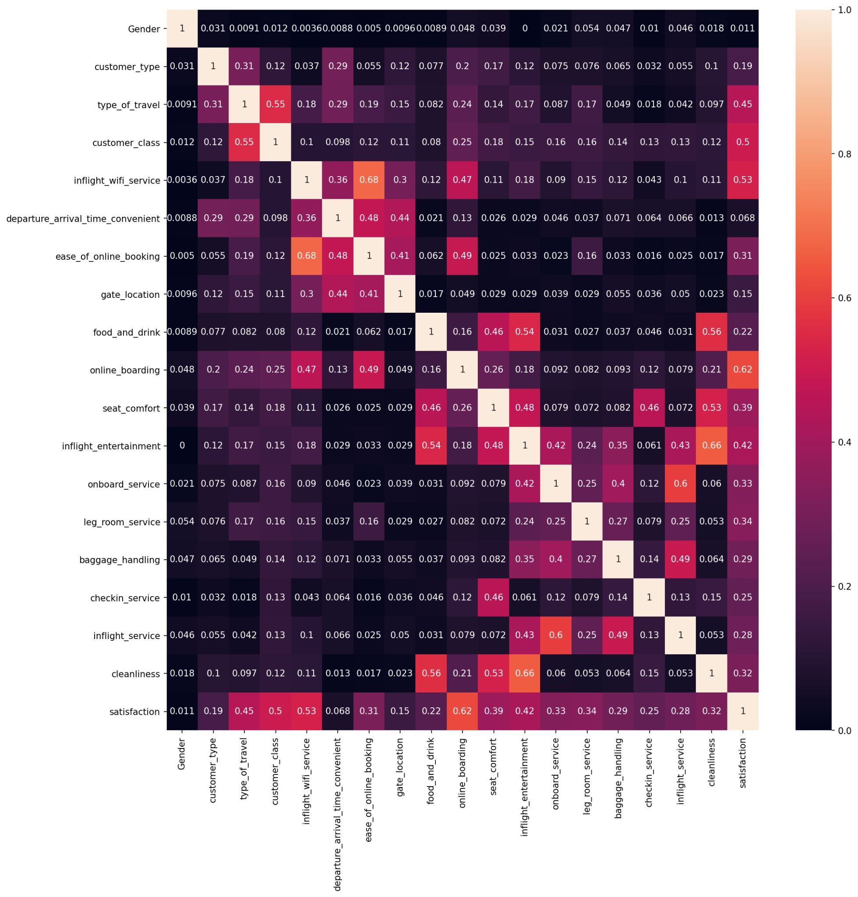
Summary of Descriptive Analysis
Online Boarding has a better correlation between satisfaction than other variables.
Inflight-entertainment and cleanliness has a correlation.
Inflight Wi-FI services and ease of online booking has a good correlation.
Onboard service and inflight service has a high correlation. It is because the both refer similar services.

Slide 12
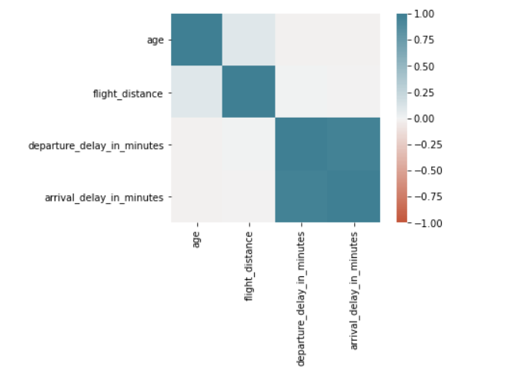
Summary of Descriptive Analysis
It can be seen that there is high correlation between departure_delay_in_minutes and arrival_delay_in_minutes.
It is because if an airplane arrives late it has more chance to departure late as they have to clean and refill and recheck the airplane.

Slide 13

Results of Advanced Analysis

Slide 14
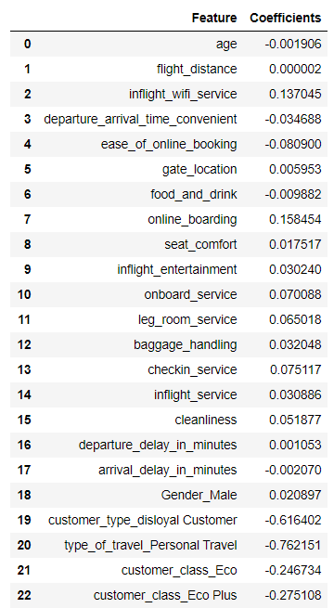
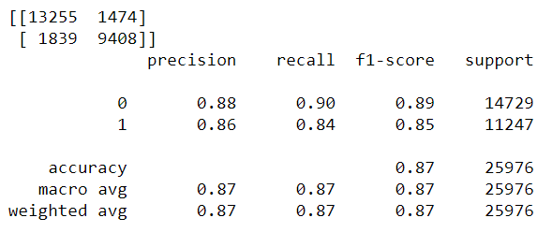
Logistic Regression with Ridge Penalty

Slide 15
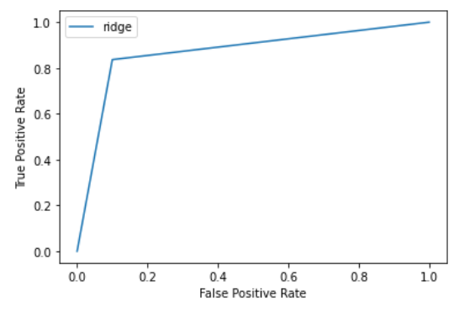
Logistic Regression with Ridge Penalty
Accuracy | 87%
ROC_AUC | 0.87

Slide 16
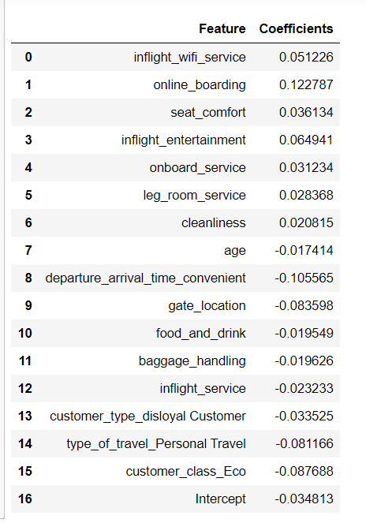
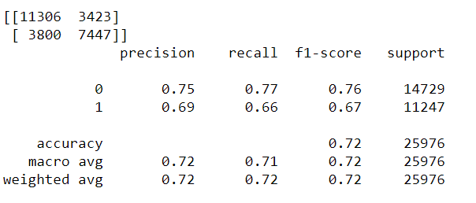
Logistic Regression with Lasso Penalty

Slide 17
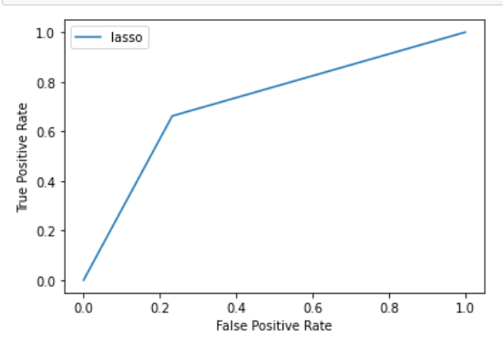
Logistic Regression with Lasso Penalty
Accuracy | 72%
ROC_AUC | 0.71

Slide 18
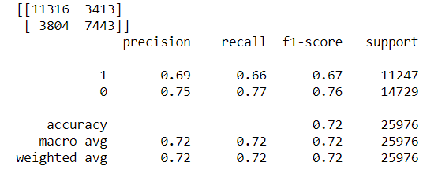
Logistic Regression with Elastic Net
Accuracy | 72.22%
ROC_AUC | 0.72

Slide 19
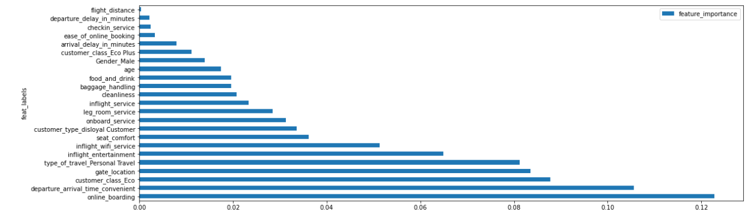
Logistic Regression with Elastic Net

Slide 20
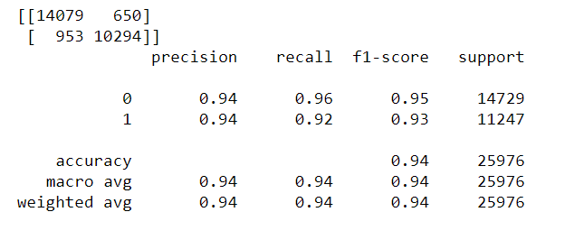
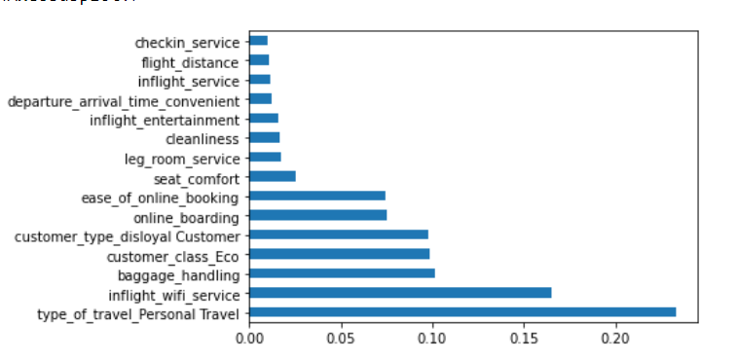
Decision Tree Classifier

Slide 21
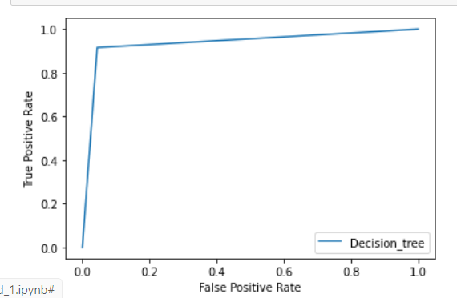
Decision Tree Classifier
Accuracy | 93.83%
ROC_AUC | 0.93

Slide 22
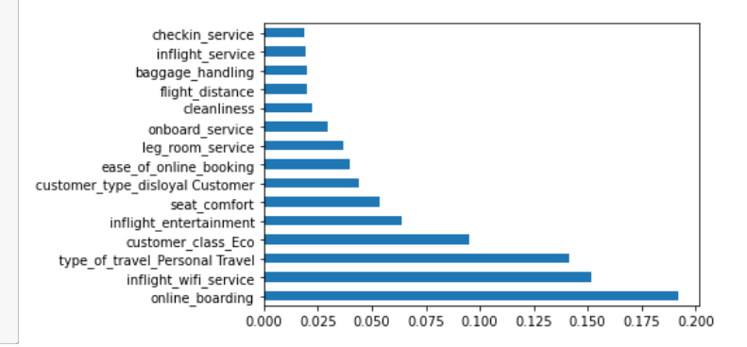
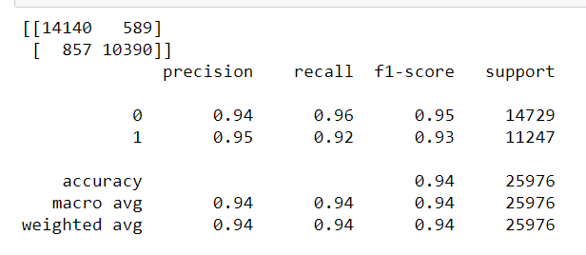
Random Forest Classifier

Slide 23
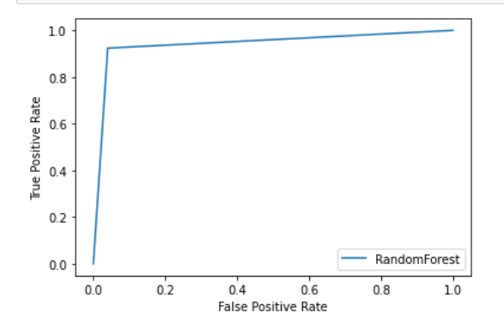
Random Forest Classifier
Accuracy | 94.43%
ROC_AUC | 0.94

Slide 24
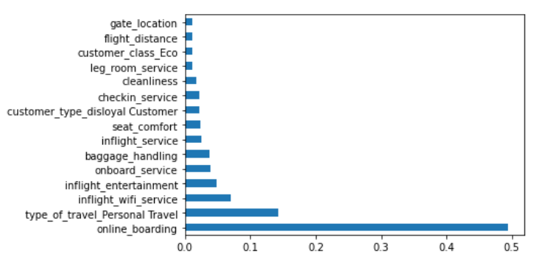
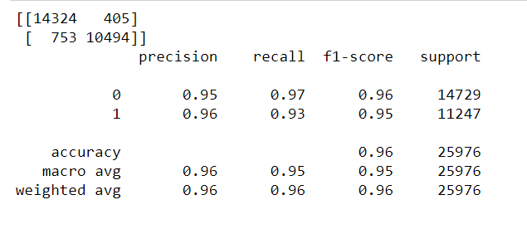
XG boost Classifier

Slide 25
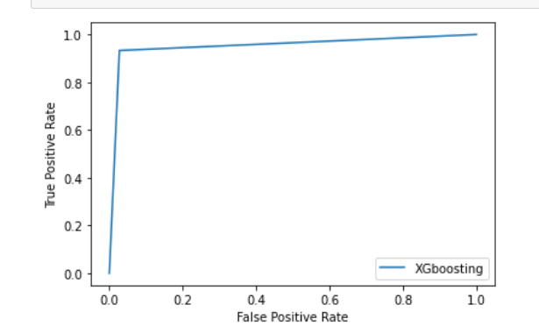
XG boost Classifier
Accuracy | 95.54%
ROC_AUC | 0.95

Slide 26
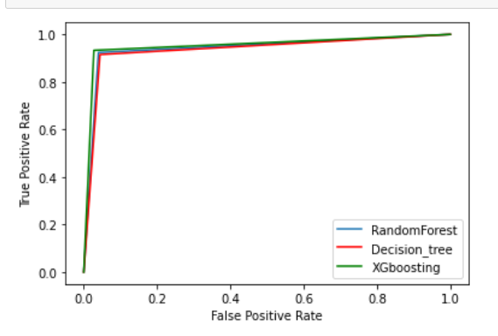
Summary of Advanced analysis
Classifiers | AUC | Accuracy
Logistic with ridge | 0.87 | 87%
Logistic with lasso | 0.71 | 72%
Logistic with elastic net | 0.72 | 72.22%
Decision Tree | 0.93 | 93.83%
Random forest | 0.94 | 94.43%
XG Boost | 0.95 | 95.54%

Slide 27
Issues Encountered and Proposed solution
We had comparatively few missing values for the variable ‘arrival delay in minutes’ which is skewed. It has been recommended to use the median for skewed data with outliers. (Data Analytics) Therefore, we have imputed the missing values using the median.
We had a significant association between predictor variables. variables.
It has been stated to use regularization like Ridge, Lasso, and Elastic Net for Logistic Regression when there are associations between variables. (Datacamp) Therefore, we have fitted logistic regression with ridge penalty, lasso penalty, and elastic net.
Tree-based classifiers are less sensitive to multi-collinearity and do not affect much in prediction. (Wiley Online Library) Hence, we have fitted Decision Tree, Random Forest, and XGBoosting.

Slide 28
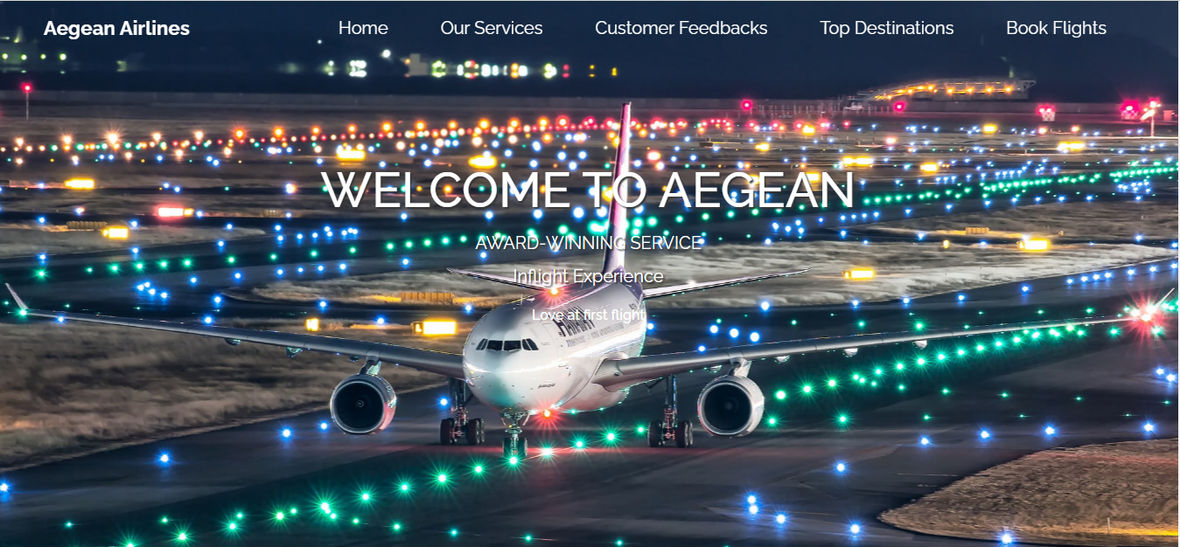
Aegean Airlines Website
A website is used as the data product which predicts whether a customer is satisfied or not.
Flask package in python is used to develop the backend of the website.

Slide 29
References
SKYTRAX. 2021. Airline Cabin Cleanliness | SKYTRAX. [online] Available at: <https://www.worldairlineawards.com/airline-cabincleanliness/>
Hiemstra-van Mastrigt, S., 2015. Comfortable passenger seats: Recommendations for design and research.
Asc.ohio-state.edu. 2021. Legroom - Wiki - SmarterTravel.com. [online] Available at: <https://www.asc.ohiostate.
edu/wilkins.5/group/travel/pitch.html> .
Mason, M., 2017. The use of the internet and social media by young people.
Putri, M., Harisha, A. and Widyastuti, S., 2018. SELF AND MOBILE CHECK-IN ARE PLAYING IMPORTANT ROLE IN INCREASING CUSTOMER SATISFACTION. Proceedings of the Conference on Global Research on Sustainable Transport (GROST 2017),.
Covington Travel. 2021. 5 Reasons You Need to Fly Business Class - Covington Travel. [online] Available at: <https://www.covingtontravel.com/2019/02/5-reasons-need-fly-business-class/>.
Inmarsat Corporate Website. 2021. Inflight Wi-Fi. [online] Available at: <https://www.inmarsat.com/en/solutionsservices/aviation/solutions/inflight-wi-fi.html>.
Han, H., Lee, K., Chua, B., Lee, S. and Kim, W., 2019. Role of airline food quality, price reasonableness, image, satisfaction, and attachment in building re-flying intention. International Journal of Hospitality Management, 80, pp.91-100.
Mohd Zahari, M., Salleh, N., Kamaruddin, M. and Kutut, M., 2011. In-flight Meals, Passengers’ Level of Satisfaction and Re-flying Intention.
Han, H. and Hwang, J., 2014. In-flight physical surroundings: quality, satisfaction, and traveller loyalty in the emerging low-cost flight market. Current Issues in Tourism, 20(13), pp.1336-1354.

Slide 30

Thanks!
Does anyone have any questions?

